Slide 1
Problem Statement Worksheet (Hypothesis Formation)
On average does Big Mountain Resort have longer ski runs and/ or more lifts than other resorts that lead to higher operating costs and therefore would justify a higher price?
H
1
Context
4
Constraints within solution space
Big Mountain resort is a ski resort in Montana. They have just added an additional ski lift to accommodate their roughly 350,000 skiers annually. This has significantly risen the operating costs for them. Using a more data driven approach, management would like to know if they are able to justify an increase to their ticket prices.
The resort might be open too long to justify the higher price due to exclusivity of other resorts.
Price can only go so high before it becomes a deterrent
2
Criteria for success
5
Stakeholders to provide key insight
The premium charged over the average ticket by Big Mountain must be justified by the ratio of longer/ more lifts than on average in the park.
Jimmy Blackburn, Director of Operations
Alesha Eisen, Database Manager
3
Scope of solution space
6
Key data sources
The ticket price will only be raised as long as costs are offset by revenue made.
CSV file from database
H
D
E
I
P
Notes:
Hypothesis: Create a Hypothesis with an emphasis on SMART principles. (S – Specific, M – Measurable, A – Achievable, R – Realistic, T – Timebound). If you cannot do this, you do not have a good grasp on the business problem.
Context: With context, we have clearly identified the problem at hand and have elucidated on how our initiative may solve this problem, alongside the commercial implications this will have on the business.
Criteria for Success: Clearly defining the criteria for success ensures that the scope of your work is clearly defined and understood. Otherwise, if this isn’t defined – your work will never end which will result in mismatched expectations.
Scope of Solution Space: Scoping out the solution space ensures that the business initiative is SPECIFIC for a certain segment or area. This prevents solutions that have been developed being scaled and applied for all other business units that the solution may not be responsible or scalable for.
Constraints within Solution Space: Looking forward, what are the foreseeable problems we are likely to encounter? Could this be stakeholder resistance? Could this be we don’t have access to the right data?
Stakeholders to provide key insight: Who are the people I need to speak to, to get the answers I need for my data analysis?
What key data sources are required?
Based off my discussions with the key stakeholders – can we clearly list out all the data sources we need so we can make a highly targeted request as opposed to a scatter-gun approach where we ask for a bit of everything?

Slide 2
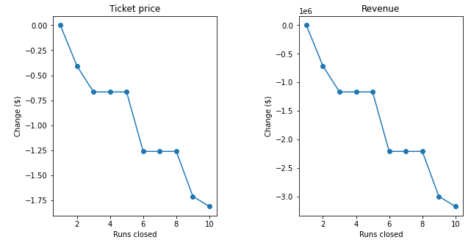
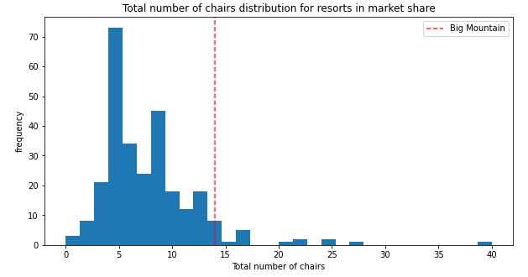
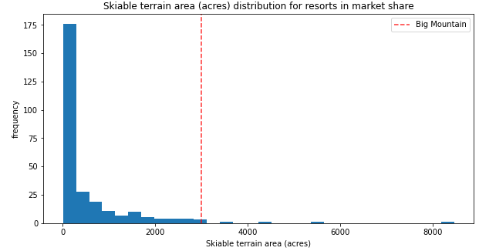
A price of $95 is suggested. Increase of $14
5 runs and a new chair lift would also be implemented.
Extra cost per ticket holder of $7.86 is expected

Slide 3
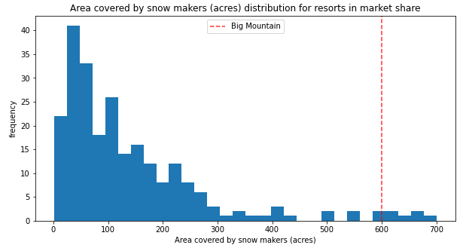
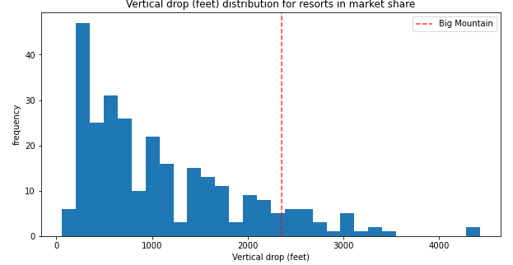
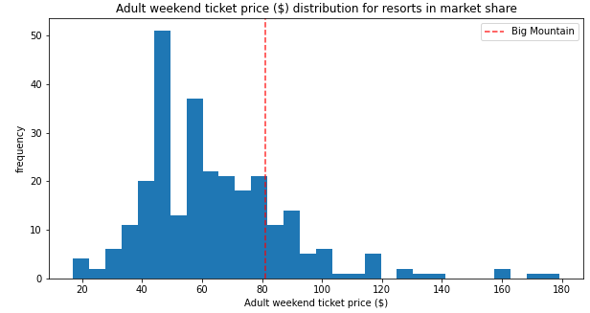
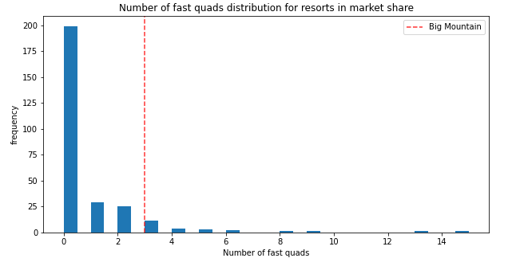
Comparison of Big Mountain against National

Slide 4
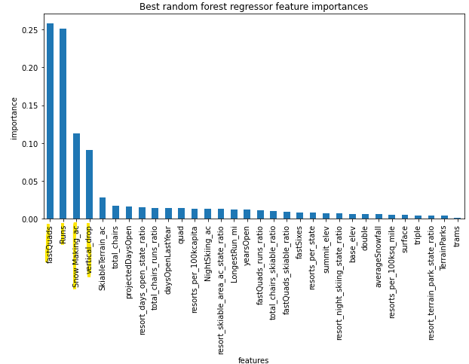
Key features in model

Slide 5
Summary
Further exploration
Other revenues received apart from tickets
Operating costs for each run
Key things to remember
Large skiable area
Long length of runs

